Slide 1
KEEPING HEALTHY
BY
SUSHIL VARMA

Slide 2

Health is state of complete physical, mental
And social well being.

Slide 3

Good health is so important for us to live a happy life

Slide 4


Slide 5
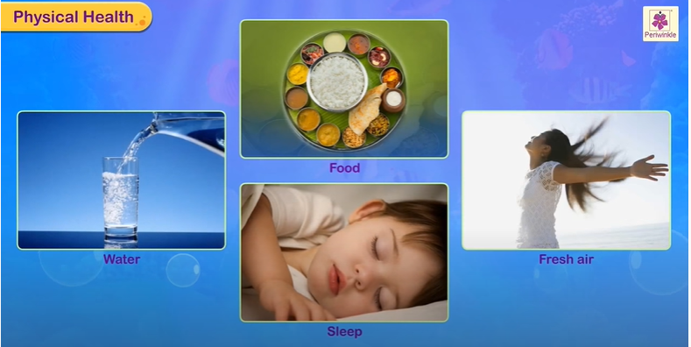
For Physical Health to our body need good food, water, sleep and fresh air

Slide 6

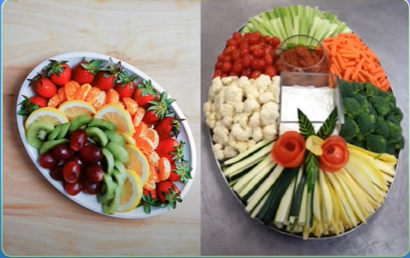
Food
Eat a healthy break fast
Eat fruits and vegetables

Slide 7

water
Drink at least 2-3 liters of water daily

Slide 8

sleep
Get sufficient rest and sleep

Slide 9
Thank You.

